Slide 1
Modelling of chatter vibration in thin-wall turning and its effect on surface roughness of job
Submitted by P-5, Group-2:
Khankhoje Sanyam Pradeep 2017B5A40933P
Vaibhav Srivastav 2017B5A40974P
Sachin Thakur 2018A4PS0114P
Kanishk Chaudhary 2018A4PS0481P
Deshmukh Mihir Abhay 2018A4PS0508P
Submitted to
Dr Tufan Chandra Bera, Department of Mechanical Engineering
on 24 November, 2020
For the Course
ME F313 - Production Techniques II

Slide 2
Introduction
High speed machining processes involve dynamic conditions. Machining can be adversely affected due to unwanted vibrations which may cause damage to the tool, a poor surface finish and a lot of noise, all of which need to be avoided. All of these are extremely undesirable in any machining process, along with a bad machined part, there is higher consumption of energy and a really low efficiency.
Chatter is the relative movement between the workpiece and the cutting tool in the form of vibrations. These resultant vibrations cause waves on the machined surface. These waves are undulated after 1 tool pass and hence affect the machining in the next tool pass. These undulations cause a change in chip thickness which in turn results in a varied cutting force and a deviation from the required machining process. It is a characteristic of chatter to leave marks in the machined surface. The main cause of chatter is the lack of rigidity of a multi-component machine-tool. Most machine tools involve high dynamic movements which is why it is difficult to avoid chatter altogether. Chatter can be non-linear in high-speed machining if sudden geometry change is encountered by the cutting tool.

Slide 3
Chatter can be classified into 2 types:
i) Forced Vibrations: When the tool encounters interruption in the cutting, tool runout or external vibrations from outside.
ii) Self-Generated Vibrations: Since the chip thickness depends on the relative position between tool and workpiece during the previous tool passage, vibrations are generated due to these undulations.
Most chatter vibrations can be estimated by Delayed Differential equations. In this project we will try to solve the equations for these vibrations and the associated forces via MATLAB.
Regenerative chatter is harmful to any process, because it creates excessive vibration between the tool and the workpiece, resulting in a poor surface finish, high-pitch noise and accelerated tool wear. This in turn reduces machine tool life, reliability and safety of the operation. It is therefore very essential to predict and detect chatter where the objective is to avoid chatter occurrence in the cutting process in order to obtain better surface finish of the product, higher productivity and tool life.
Chatter can be recognized by the noise associated with these vibrations, by the chatter marks on the cut surface, and by the appearance of the chips produced in turning. Machining with chatter is not desired because of the chatter marks on the surface and because the large and fluctuating peak values of the variable cutting forces, which might cause breakage of the tool or of some other part of the machine. Chatter is often a factor limiting metal removal rate below the machine’s capacity and hence reduces the productivity of the machine.

Slide 4
Thin-Walled Parts and difficulties associated with machining these parts:
Thin-walled components are basically components with a wall thickness much smaller compared to the rest of the dimensions of the workpiece, like a thin-walled pipe or pressure vessels.
During the CNC turning process, the main challenge for machining thin wall parts is the deformation, which may be caused by the cutting force, which leads to the shape becoming elliptical or small in the middle and big at both ends. In addition, due to the casing of thin wall workpiece, poor heat dissipation further resulting in thermal deformation.
The thin-walled parts can not bear large radial force, so it is difficult to install with general clamps.
Improper clamping, improper clamping force, and poor rigidity of thin wall parts lead to large deformations.
The elastic recovery of the workpiece under normal conditions will affect the dimensional accuracy and shape accuracy.
Unreasonable fixture design causes positioning error.
The cutting heat will also affect the control of parts dimension accuracy.
Due to the cutting forces, the workpiece is prone to vibration or deformation, and results in low surface quality and inaccurate size of parts.
If the cutting amount is a lot, the production efficiency will be impacted.
Due to the further lack of rigidity caused due to clamping constraints in thin-walled turning it becomes even more important to analyse the self generated chatter vibrations as the incremental nature of these vibrations can completely damage the job and destroy the profile initially required by the user.
The steps to improve the machinability of these parts include:
Ensuring uniform clamping of the workpiece
Analyzing chatter vibrations and making suitable adjustments to the machining process.
It is always suitable to first machine the inner surface of the thin wall and then the outer wall since the inner-wall is more susceptible to deformation.
It is always suggested that the machining process be completed in 1 setup. Since every setup comes with it’s own calibration and possible errors associated with it. Thus, especially for critical thin walled components the clamping should be designed such to not have multiple setups.

Slide 5
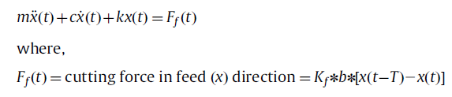
Chatter model
Considering a 1 Degree of Freedom (SDoF) orthogonal turning process, with a ﬂexible tool and rigid workpiece, the model incorporates various forces acting on the physical system like the damping force, inertia force, cutting force, and the spring force. A sharp tool is considered with only the cutting force in feed direction acting in the system. The equation of motion of the dynamic system can be modeled in the radial (feed) direction as:
Kf is the cutting coefﬁcient in the feed direction
· b is the chip width (width of cut), mm,
· T is the time delay between the current time and previous time,
· [x(t-T)- x(t)] is the dynamic chip thickness due to tool vibration.

Slide 6
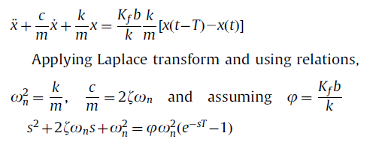





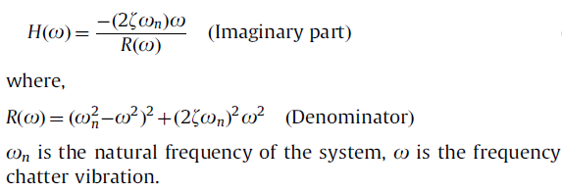

The limiting width of cut (b-lim), at which the turning process switches from stable to unstable can be found by the relation of b_{lim} .
The stability equation leads to a positive real depth of cut only when the real part of the transfer function between the tool and workpiece is negative. So, this equation gives only an absolute depth of cut when the minimum (most negative) value of G is considered.

Slide 7
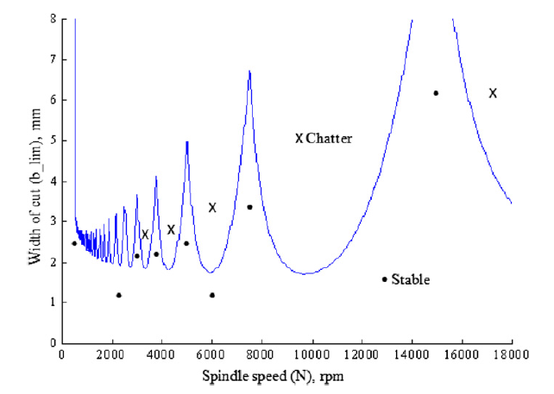

Slide 8
Stability Lobes Diagrams and their use
The most signiﬁcant cutting parameter, which decides the generation of chatter in a turning process, is the depth of cut (chip width) b. When the chip width is smaller, the cutting process is more stable. By increasing chip width, chatter starts to occur at a certain chip-width b-lim (limiting depth of cut) and becomes more energetic for all values of b>b-lim. The value of blim depends on the dynamic characteristics of the structure, on the workpiece material, cutting speed and feed, and on the geometry of the tool. On the SLD, the limiting depth of cut blim is plotted against spindle speed (N). Vibrations between the tool and workpiece appear on the plot as different lobes and any depth of cut and spindle speed combination which falls below these lobes results in a stable operation, also known as “chatter free”, and above these lobes in an unstable (chatter present) operation. By using SLDs, thus it becomes relatively easy to select ideal spindle speed and depth of cut combinations for maximizing MRR in a turning process.

Slide 9
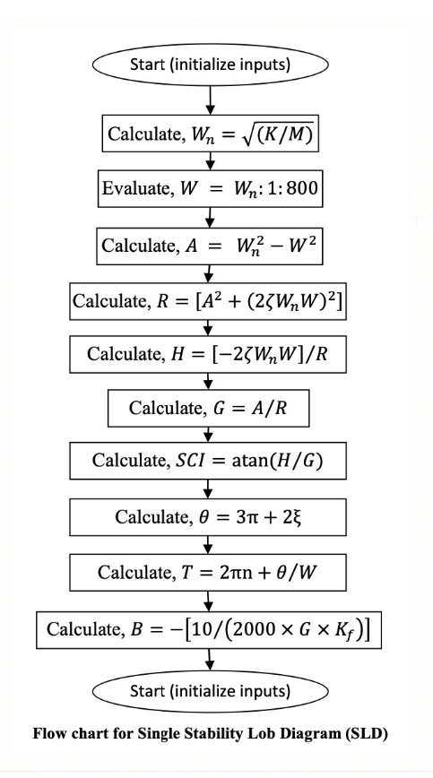

Slide 10
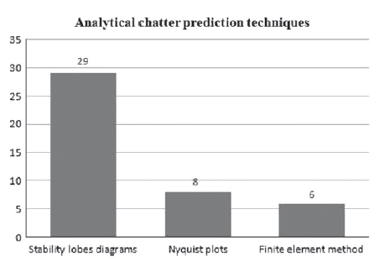
The construction of stability lobe diagrams is the most popular technique because of its clarity and simplicity in defining unstable and stable cutting states.
· The stability lobe diagrams can be produced for mathematical models containing any number of DoF (degrees of freedom) cutting processes. For higher degrees however, Nyquist criterion of stability is used to give the SLD diagrams.
This figure shows the number of publications over the years for SLD techniques over other techniques, and hence we prefer using the SLD technique in this project:

Slide 11
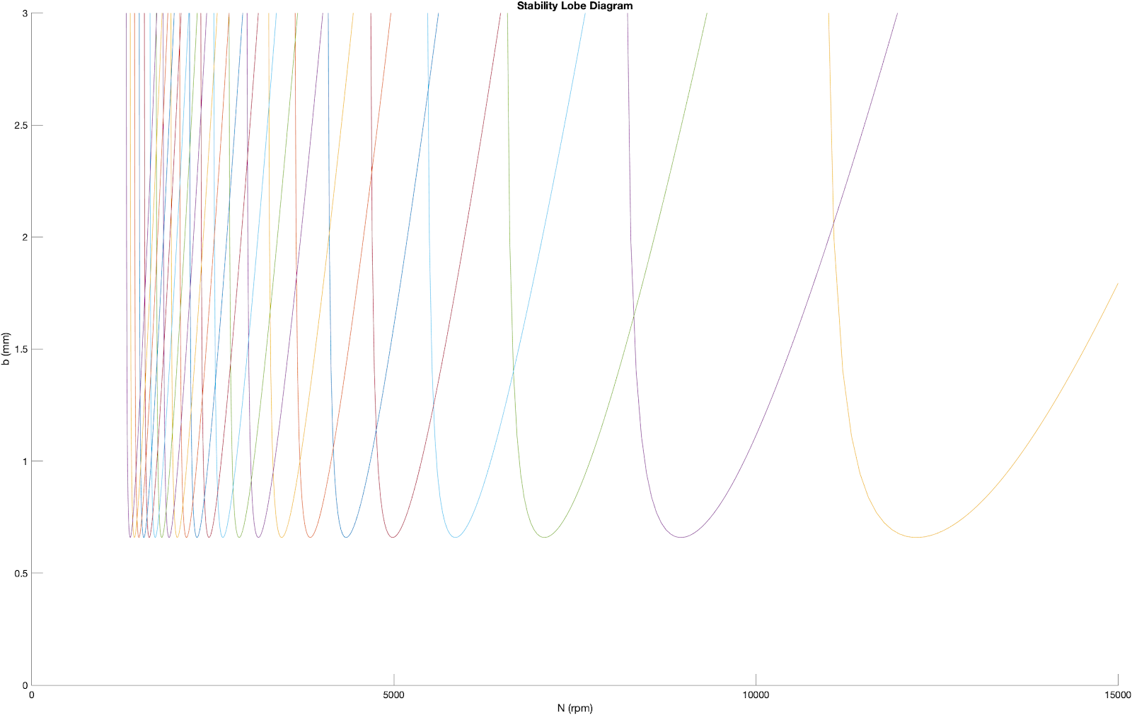
MATLAB Code graph
Using the MATLAB code as given in the appendix, the raw graph obtained is given in the figure below. The constants taken are: m = 0.561; k = 6.48e6; c = 145; Kf = 1384.

Slide 12
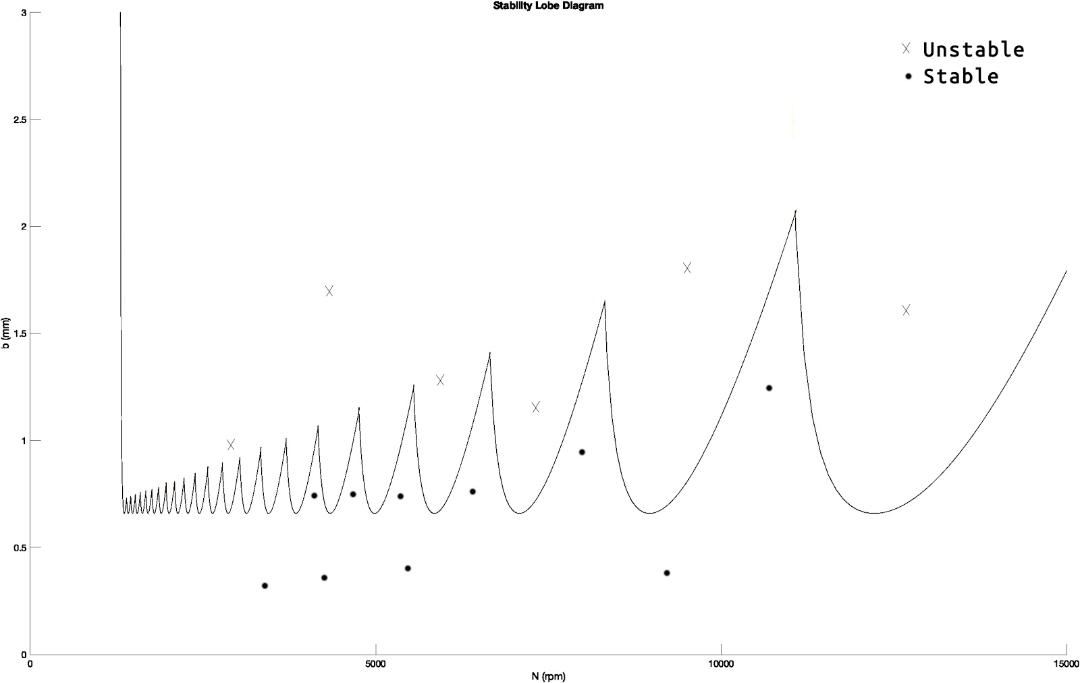
The chart includes lobes for each mode of vibration and provides the limiting depth of cut for each spindle revolution. Above each lobe, chatter occurs. We have taken 25 lobes in this graph.
The chart was formatted and cleaned to make it more informative. All intersection plots were removed, and only the limiting values were shown. The formatted chart, given below, also shows the areas of stable and unstable machining.

Slide 13
Surface Roughness due to Chatter Vibration
Roughness: Relatively fine-spaced surface irregularities. It is produced by cutting actions of the tool edge, abrasive grains and feed marks by the cutting tool.
Some factors which affect surface quality
Machine tool rigidity and bearing accuracies.
Finishability of work material.
Type and condition of cutting tool.
Applications of cutting fluid.
Method of chip removal.
Geometry of cutting tool.
Cutting variables.
Chatter, which arises due to tool or workpiece vibrations, may occur due to non-rigid connections. We have solved the delay differential equation given in the first chapter to find radial displacement of the tool with respect to time. Using these radial displacements, the surface topology of the workpiece can be predicted during the chatter process.

Slide 14
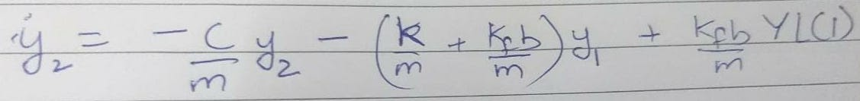
The graph of y vs t is given in the figure below. The algorithm used in obtaining the graph involves the following steps:
Converting the second order delay differential equation to state-space form.
Modelling the chatter history function, which serves as the boundary conditions - At time t = 0, tool is just touching the workpiece. y is negligible and y’ = 0.
Modelling the dde function, based on the documentation given for ddesd in matlab.
Modelling the delay function = 60/N, N = 4000 rpm taken.
Use the following constants: m = 1.742 [kg], k = 7.92 · 10^6 [N/m], c = 176.8 [N/m/s], Kf = 2585 [N/mm2]
Use the following equation, plug the constants into dde function:

Slide 15
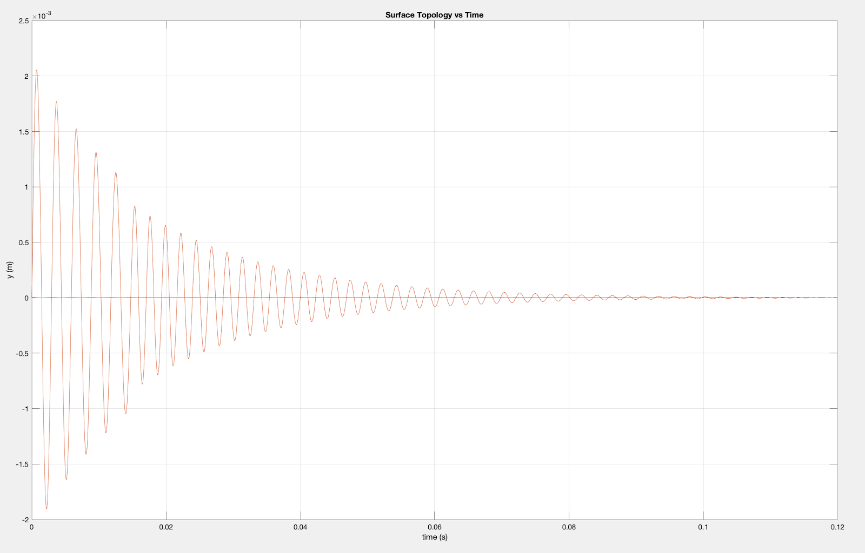

Slide 16
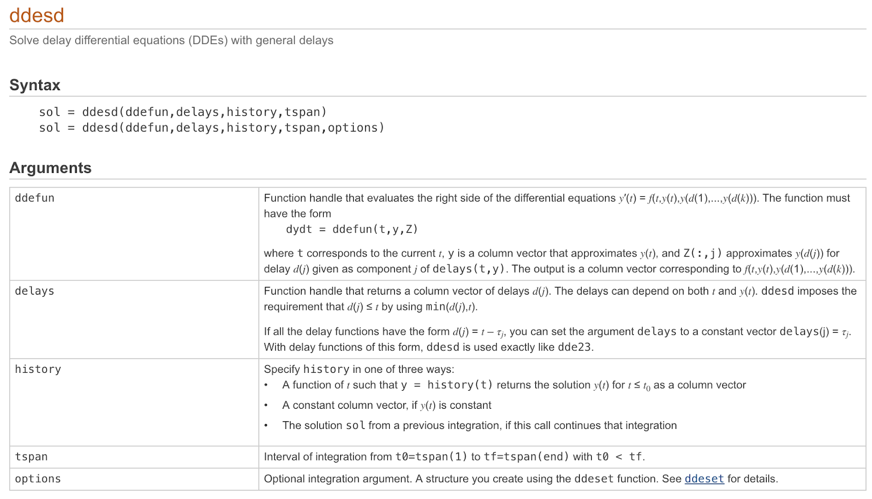
Documentation for the dde solver

Slide 17
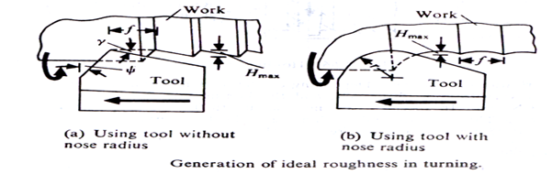




H_{avg} = H_{max} /4
Comparing chatter results with theoretical values
H_{max} obtained from solving delay differential equation = 2mm
Therefore H_{av} = H_{max}/4 = 0.5mm
H_{av,theoretical} = f/4(tanѱ +cotϒ)= 0.0113/(4*(tan(15)+cot(5))) = 0.24mm
Therefore, it can be seen here that based on the input parameters, ѱ = 15 deg, ϒ=5 deg, N = 4000 rpm, f = 0.17 mm/rev, the surface roughness in the chattered region was double that of the theoretical surface roughness obtained by orthogonal turning without chatter, assuming negligible nose radius.

Slide 18
Thank you!

